Slide 1

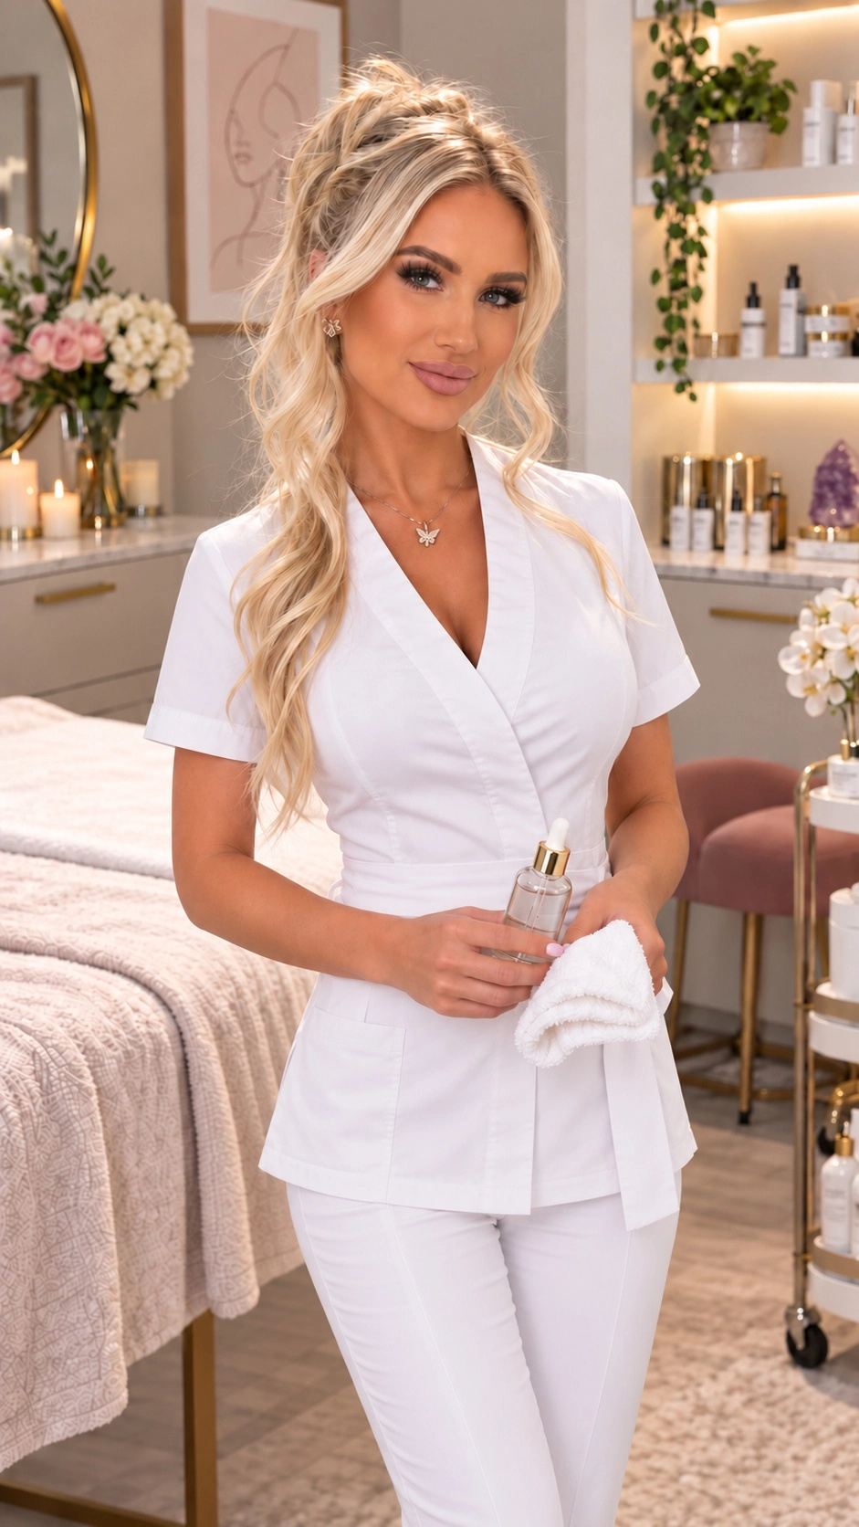
TINK
beautybytink.com
PHOENIX BEAUTY + FASHION
You bring
the talent.
I’ll help people
see it.
Websites · Video · Social · Newsletters
01
Notes:
Hi, I'm Emma, and this is Beauty by Tink. You opened your business to do something you love. Then somehow you also became the website person, the video editor, and the person asking, 'Wait, did we post this week?' I help beauty and fashion businesses bring it all together: a beautiful website, engaging videos, social content, and newsletters. You bring the talent. I'll help people see it.
Visuals: Beauty by Tink website assets. Emma presenter: existing private HeyGen avatar, with approved Emma narration. Decorative silk background generated for this presentation.

Slide 2
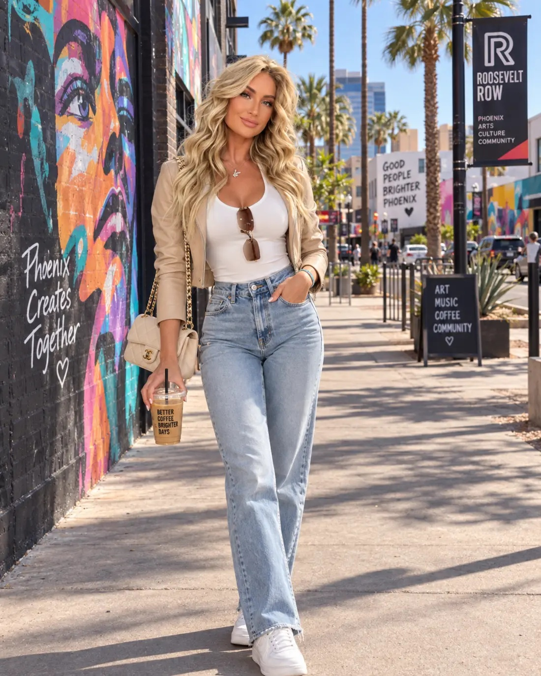
TINK
beautybytink.com
WHY I DO THIS
Your work deserves
a proper introduction.
The care you put in.
The personality people love.
The reason they choose you.
Before they arrive.
02
Notes:
I'm building Tink here in Phoenix because I believe a small business can have a big personality, and its marketing should let that personality breathe. Your customers feel the care when they sit in your chair, walk into your shop, or meet you for the first time. I want them to feel a little of that before they arrive. That's where a good introduction can make a real difference.
Visuals: Beauty by Tink website assets. Emma presenter: existing private HeyGen avatar, with approved Emma narration. Decorative silk background generated for this presentation.

Slide 3
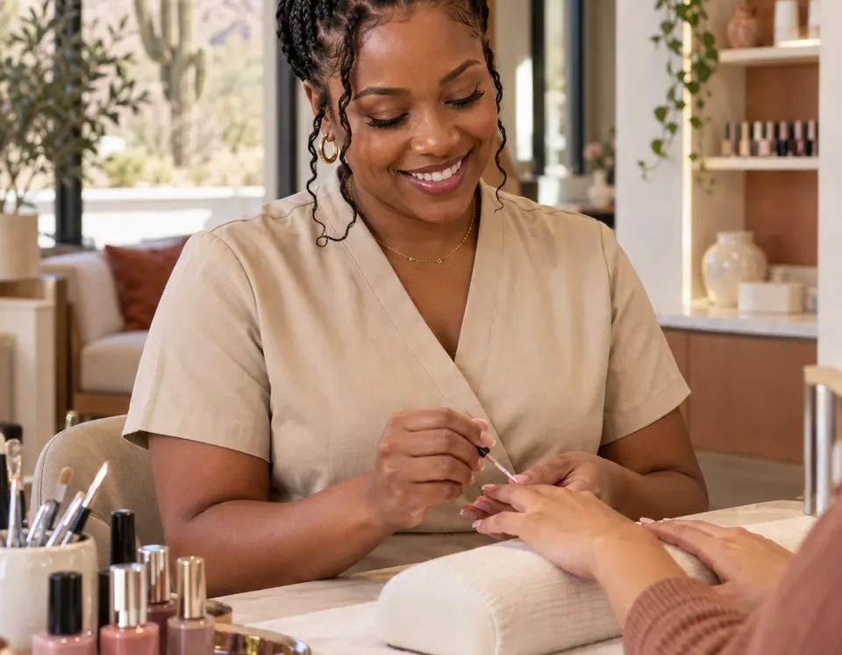
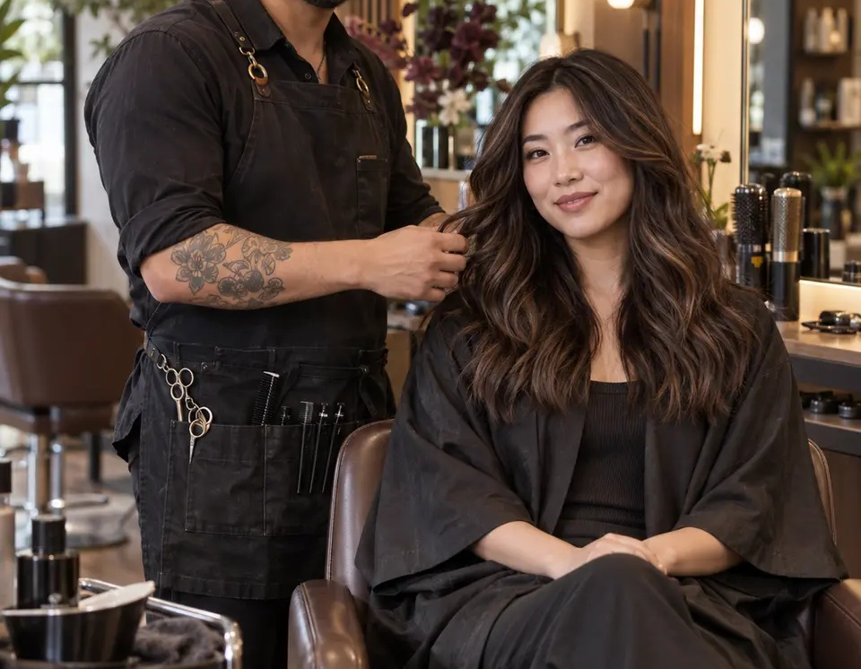
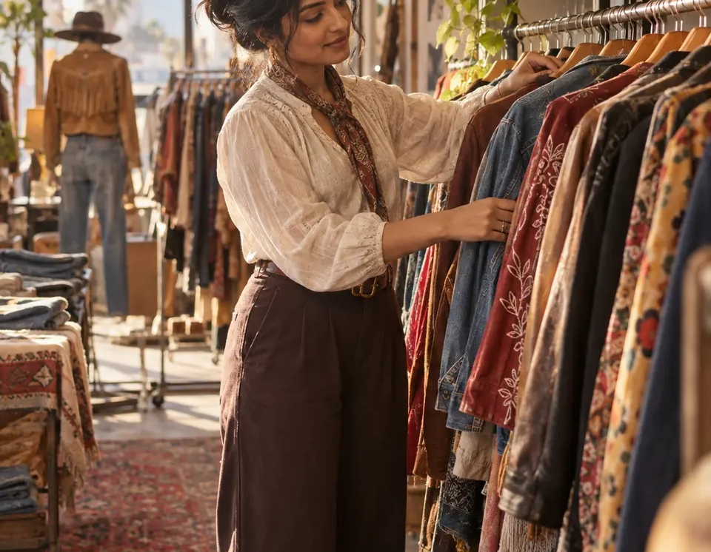
TINK
beautybytink.com
ONE CONNECTED PRESENCE
One business. One unmistakable you.
Explore
Discover
Stay connected
A website that feels like you
Video + social with personality
A newsletter worth opening
Illustrative portfolio concepts
03
Notes:
Here's the idea: your website, videos, social posts, and emails should feel like they belong to the same business. Same personality. Same message. A clear next step. A lovely Instagram post loses its magic if the link leads somewhere confusing. I bring the pieces together, so someone can discover you, understand what you offer, and know how to book, shop, or get in touch. Much less digital hide-and-seek.
Visuals: Beauty by Tink website assets. Emma presenter: existing private HeyGen avatar, with approved Emma narration. Decorative silk background generated for this presentation.

Slide 4
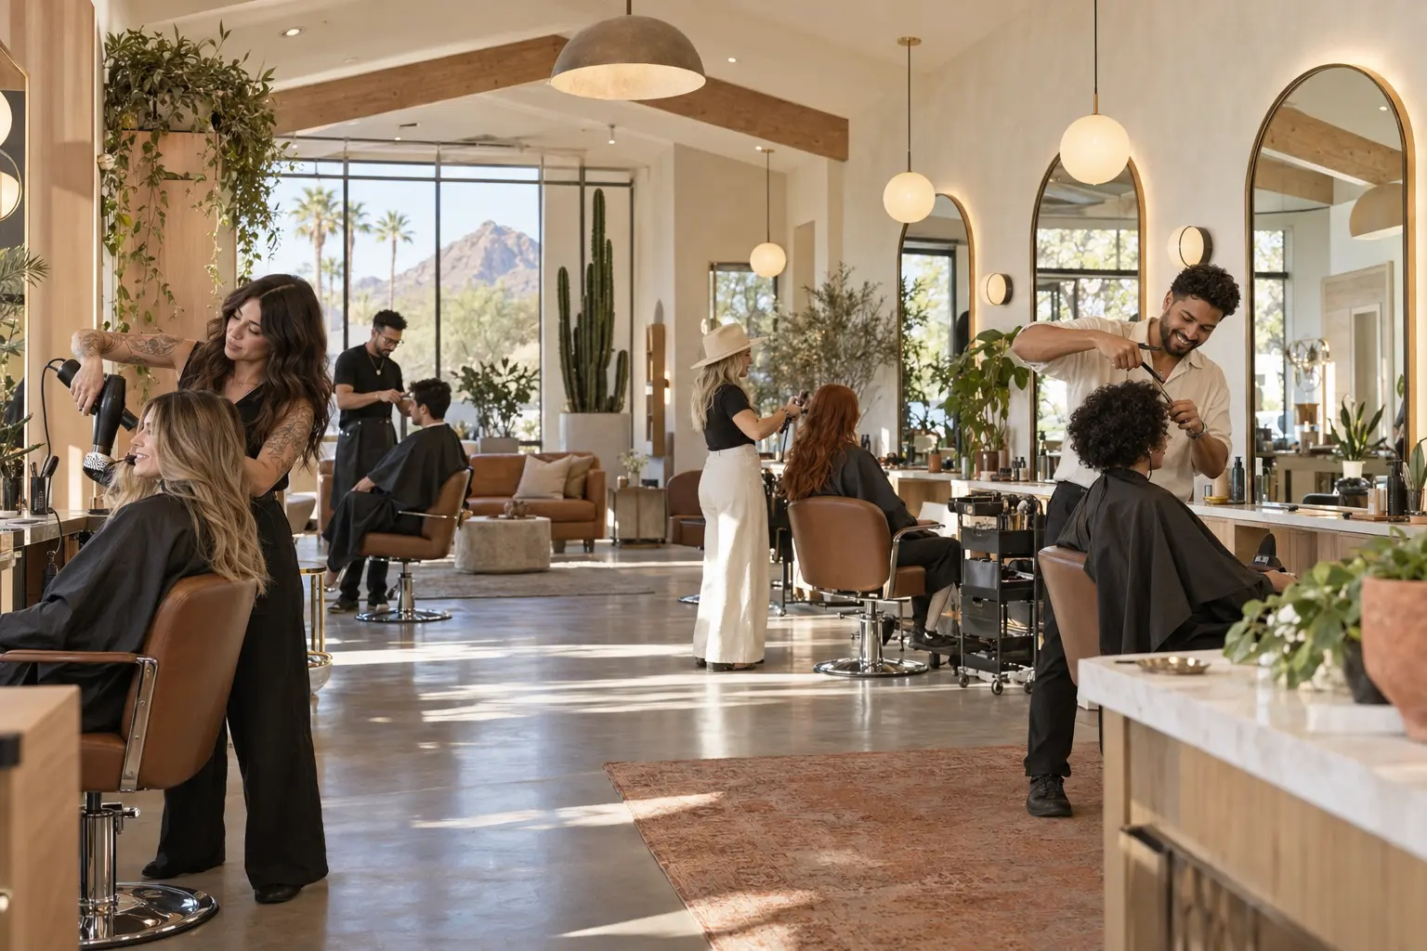
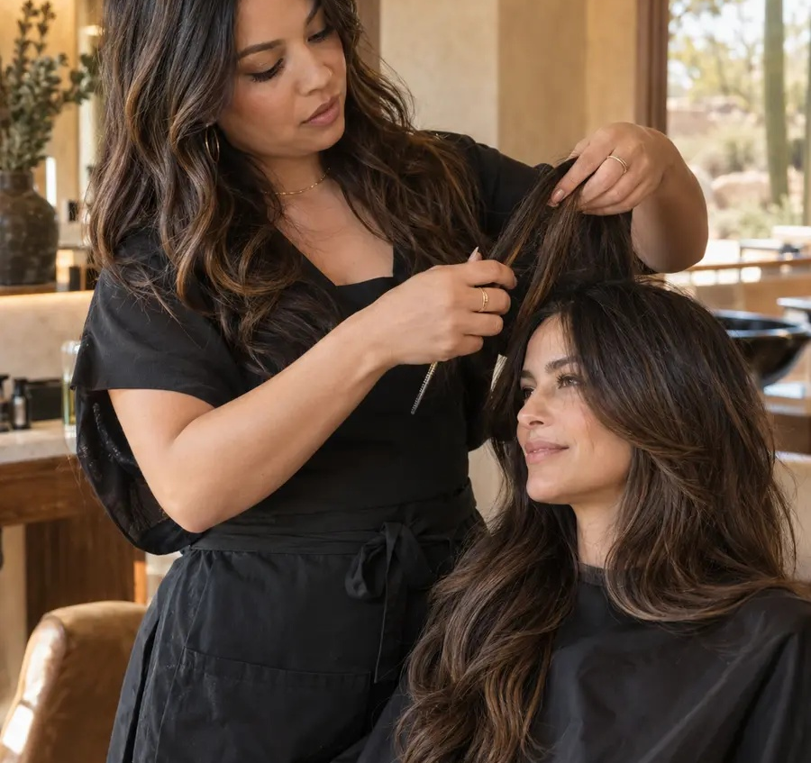
TINK
beautybytink.com
YOUR WEBSITE
Pretty. Useful.
Easy to say
yes to.
Beautiful is the starting point.
Show your work
Answer the obvious questions
Make the next step clear
Illustrative concept · Arcadia House
04
Notes:
Let's start with your website. It should show your work beautifully, explain your services, and make the next step easy, especially on a phone. For a salon, that might mean helping someone choose a stylist. For a boutique, it's making the latest collection easy to explore. Beautiful is the starting point. Useful is what turns interest into action. And the booking button should never require a search party.
Visuals: Beauty by Tink website assets. Emma presenter: existing private HeyGen avatar, with approved Emma narration. Decorative silk background generated for this presentation.

Slide 5
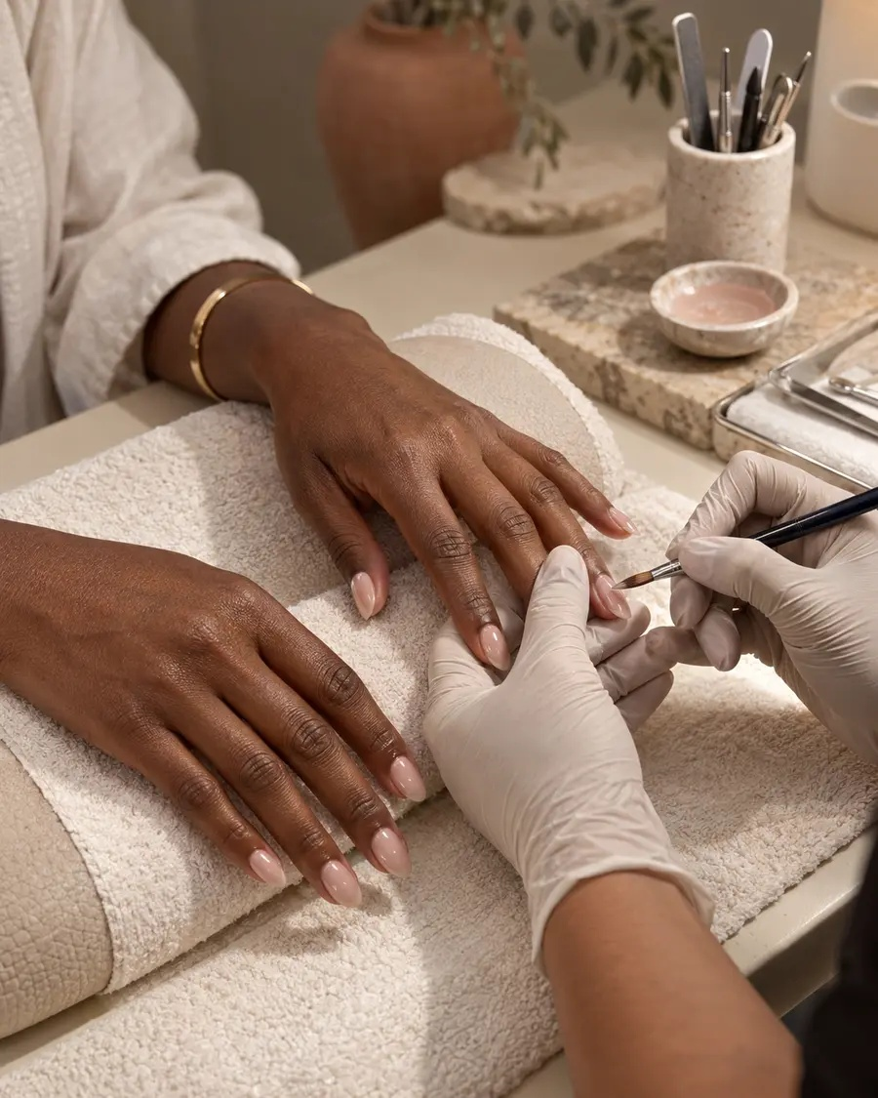
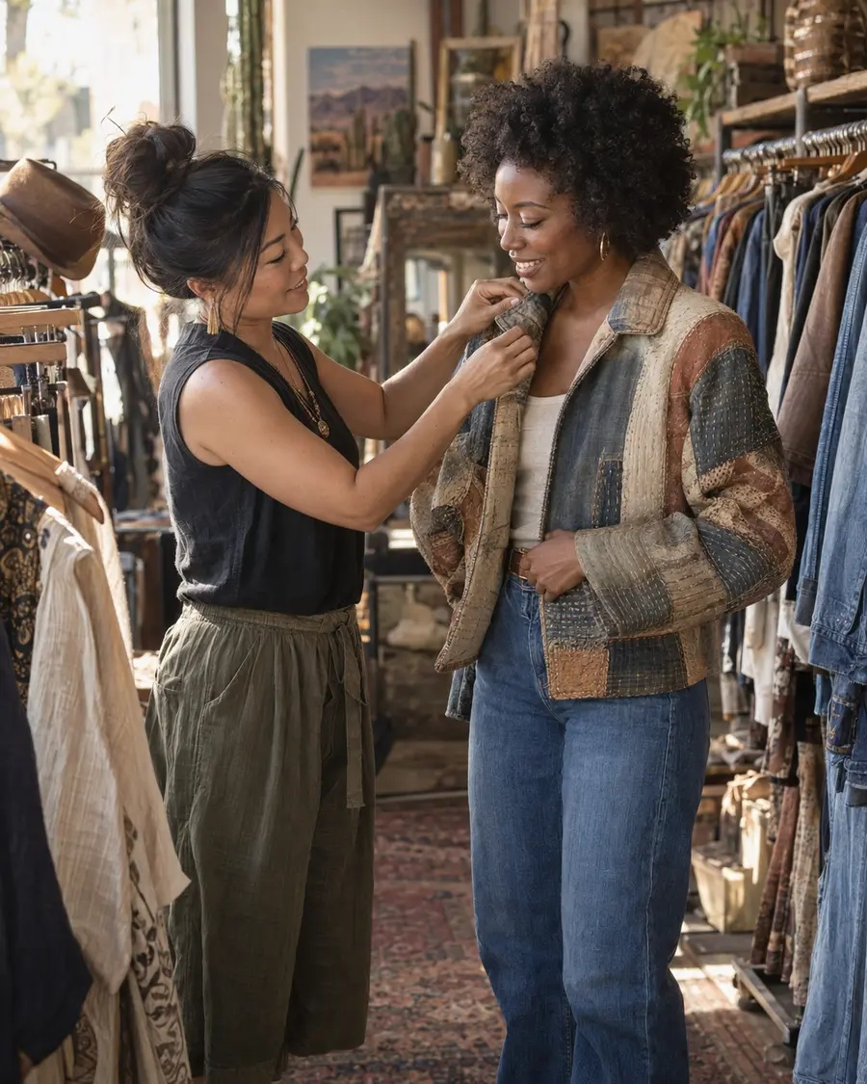
TINK
beautybytink.com
VIDEO + SOCIAL
A little
scroll-stopping.
A lot of you.
Show the craft.
Introduce the person.
Give people a reason to care.
Personality included.
Illustrative portfolio concepts
05
Notes:
With video and social content, I help people see what makes your business special: the beautiful detail, the personal touch, the person behind it all. We can introduce a service, tell your story, or create excitement around something new. Your content can be fun and still have a job to do. And no, running a lovely business does not mean you also have to become a full-time ring-light influencer.
Visuals: Beauty by Tink website assets. Emma presenter: existing private HeyGen avatar, with approved Emma narration. Decorative silk background generated for this presentation.

Slide 6
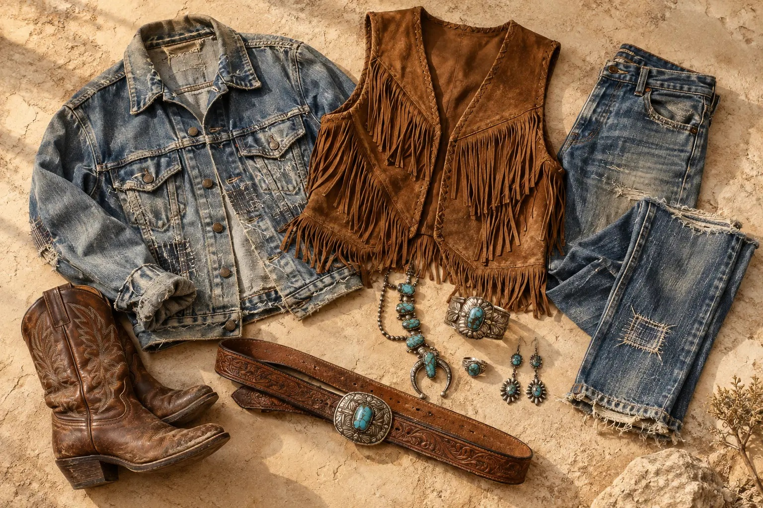
TINK
beautybytink.com
NEWSLETTERS WITH SOMETHING TO SAY
An email worth opening.
THE THURSDAY DROP
You’re in early.
Useful tips
Fresh finds + local inspiration
A thoughtful invitation to return
Give readers something worthwhile.
Illustrative newsletter concept · Found in Phoenix
06
Notes:
A newsletter gives you a way to keep the conversation going with people who want to hear from you. Think helpful beauty tips, a new collection, local inspiration, or a lovely reason to come back. It should feel like a welcome note from a business they like. If every email says 'Buy now,' the relationship gets a little one-sided. We give people something worthwhile, then make the invitation clear.
Visuals: Beauty by Tink website assets. Emma presenter: existing private HeyGen avatar, with approved Emma narration. Decorative silk background generated for this presentation.

Slide 7
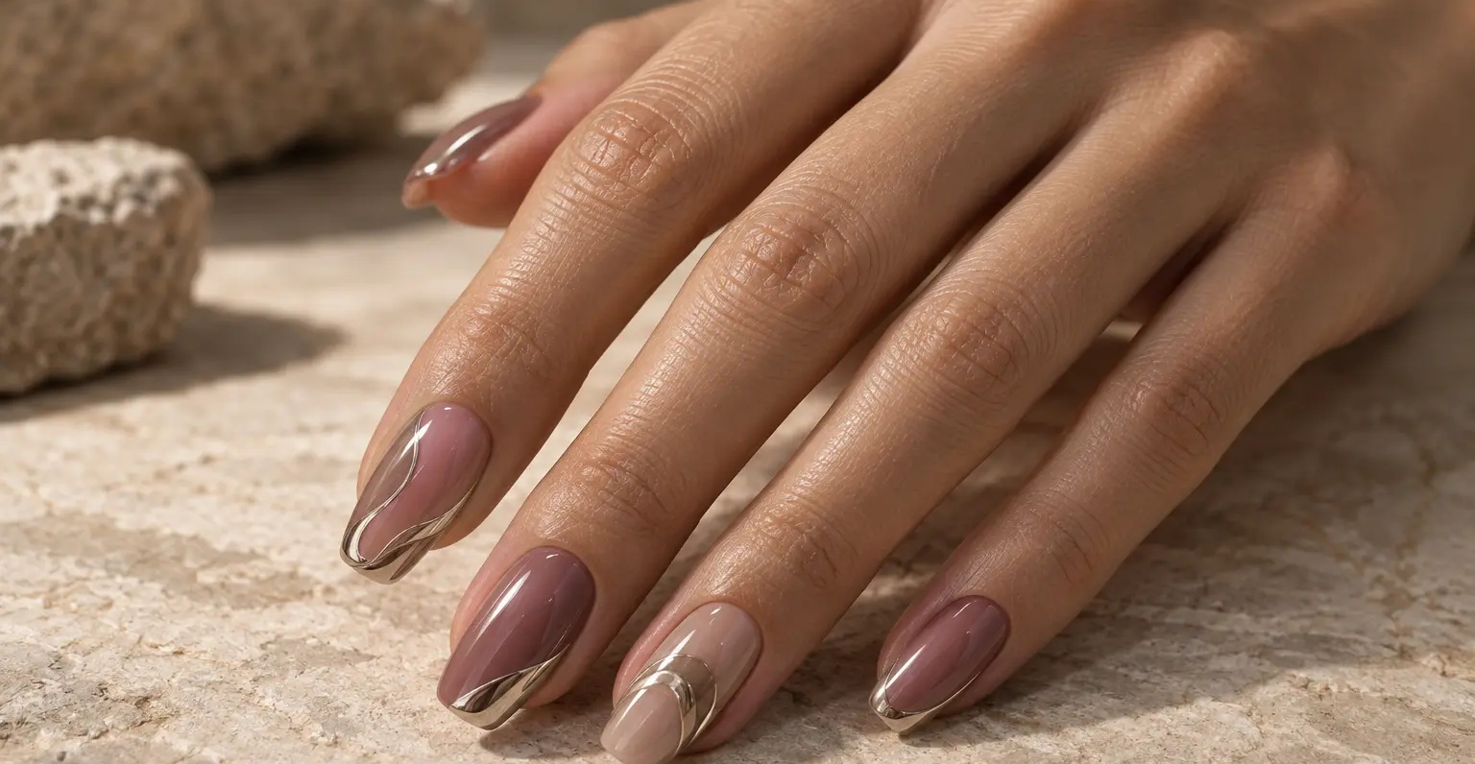
TINK
beautybytink.com
WHAT IT DOES FOR YOUR BUSINESS
Let’s give Tuesday a little
main-character energy.
01
Video + social
Catch attention
02
Newsletter
Invite subscribers
03
Booking page
Tuesday Nail Club
Make the next step easy
Illustrative concept · Desert Polish · No invented results
07
Notes:
Here's a practical example. Imagine a nail studio with beautiful work and a quieter Tuesday afternoon. We build one clear campaign: a short video that catches attention, social posts that explain the idea, a newsletter for subscribers, and a page that makes booking straightforward. Everything supports the same goal. Our Desert Polish example shows how that could look. It's an illustrative concept, so there are no invented results, just a useful idea made tangible.
Visuals: Beauty by Tink website assets. Emma presenter: existing private HeyGen avatar, with approved Emma narration. Decorative silk background generated for this presentation.

Slide 8
TINK
beautybytink.com
BEAUTIFUL VALUE
Beautiful work.
A sensible conversation.
A package shaped around your budget
Clear scope + fee agreed up front
Your brand and content stay yours
No share of your sales.
08
Notes:
And the budget matters. I want this to feel achievable for a small business. You can start with one project or bring the whole package together. We agree the work and the fee before we begin, so you know what you're getting. Your brand and your content stay yours, and we don't take a share of your sales. I want you excited about your marketing, not developing a nervous relationship with the invoice.
Visuals: Beauty by Tink website assets. Emma presenter: existing private HeyGen avatar, with approved Emma narration. Decorative silk background generated for this presentation.

Slide 9
TINK
beautybytink.com
WORKING TOGETHER
You talk. I listen.
We make it feel like you.
01
02
03
Tell me what matters
Review the direction
Approve + share
Your business. Your customers.
Your priorities.
What you love, and what needs
a little more you.
Your approval comes first.
Then we build on it.
“A little more me” is a perfectly good creative brief.
09
Notes:
Working together starts with a conversation about your business, your customers, and what could use a little help. I'll listen, shape a direction, and give you something to react to. You can tell me what you love and what doesn't feel like you. We refine it together, and you approve the work before it goes public. You don't need marketing jargon. 'A little more me' is a perfectly good creative brief.
Visuals: Beauty by Tink website assets. Emma presenter: existing private HeyGen avatar, with approved Emma narration. Decorative silk background generated for this presentation.

Slide 10
TINK
beautybytink.com
LET’S MAKE SOMETHING BEAUTIFUL
As memorable online
as you are in person.
See the work. Then let’s talk.
beautybytink.com
emma@beautybytink.com
10
Notes:
So, if you're ready for marketing that feels polished, personal, and a lot more like you, come see what we're making at Beauty by Tink. Explore the examples, picture what we could do for your business, and tell me where you'd like to start. Website, video, social, newsletter, or the whole lovely lot. I'm Emma. You keep doing what you do beautifully. Let's help the right people find it.
Visuals: Beauty by Tink website assets. Emma presenter: existing private HeyGen avatar, with approved Emma narration. Decorative silk background generated for this presentation.

